Slide 1

Post Frame Survey - PFS -2104
Assessing accuracy and coverage of housing units sampling frame
Elmogiera Elawad (PhD.)
Mohammed Agied (Msc)

Slide 2
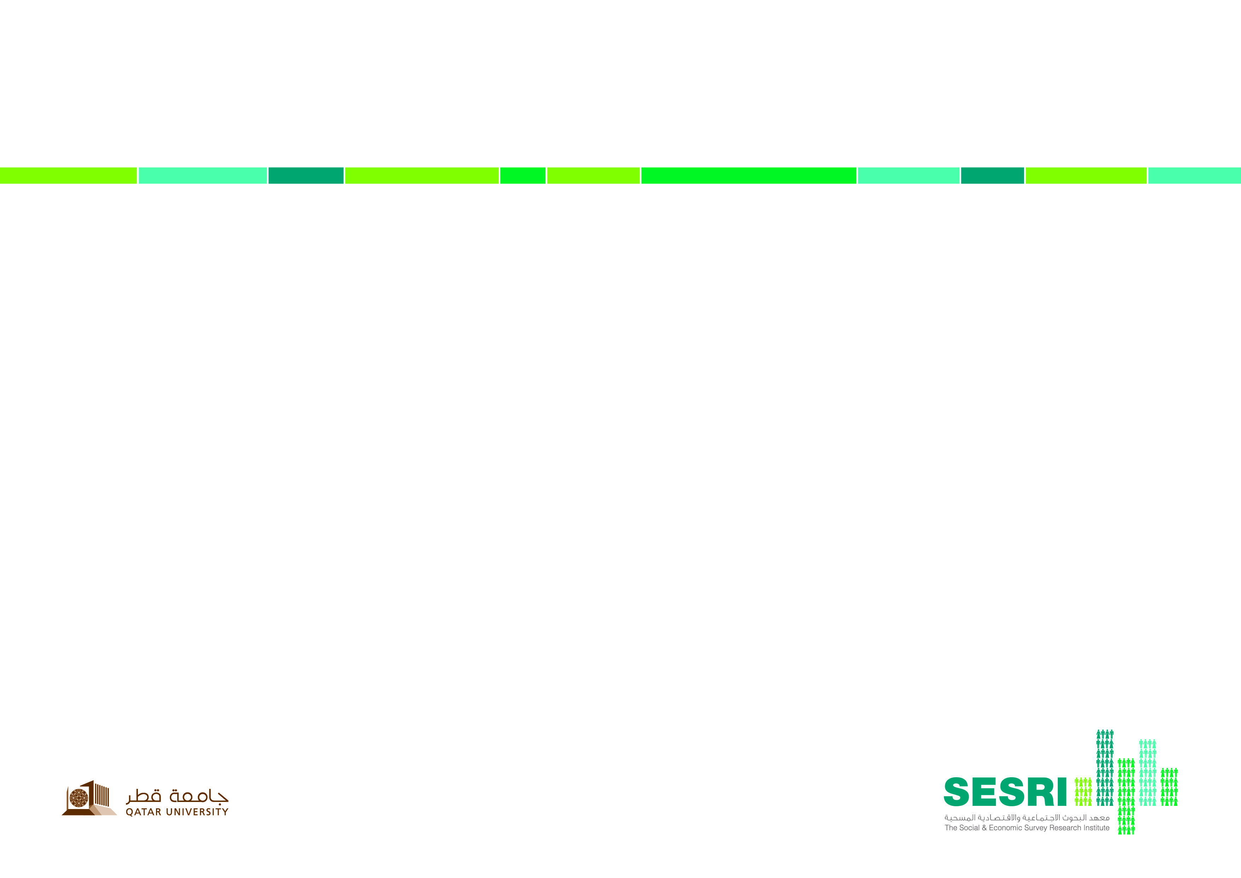
Introduction
Several methods are available to evaluate censuses, including comparison of census results with data from other sources like previous census or vital registration and matching census responses with responses from interviews conducted during Census. Post Survey- PSC

Slide 3
Introduction
The PSC is tool of evaluating censuses, considering that censuses are regularly contain 3 steps :
Counting house units
Counting establishments
Counting population
In SESRI we only concern about the first step (counting and update house units addresses), however due to sample purposes we add only one question about house units tenant nationality ? (Q&E or L)
So to evaluate SESRI house units Frame we develop in SESRI (Post Frame Survey PFS), as a major tool instead of the Post Census Survey – PCS, reverting the same methodology but different tools

Slide 4
Introduction
Basically, the PFS is an independent survey that repeats frame update. The survey results are compared with house units frame results, permitting estimates to be made of :
coverage and
content errors.
Coverage errors refer to house units missed in the census or incorrectly included, while content errors evaluate response quality of selected questions. The PFS allows SESRI to uncover deficiencies in the methodology of the frame update and make adjustments for future censuses.

Slide 5
II Objectives
The PFS will be useful to develop a good field work plan for future survey, in term of measuring time to search and reach selected household units as well as allowing estimating the accuracy of the house unit’s frame; we can say that the survey objectives are as follow :
- To estimate the coverage percentage of house units in the frame clusters.
- To estimate the accuracy of house units addresses
- To evaluate the Geographic Information System (GIS) accuracy.
- To estimate content errors

Slide 6
III Method
To estimate the coverage of house unit’s frame, we will take randomly a sample of 73 frame blocks that have been counted in the last frame, distributed to each of the 98 areas, which constitute the geographical areas of the State of Qatar, this number of blocks represent about 3% from the total number of blocks, and compare the data between the PFS result and the frame update result and estimate the differences, if any.
To estimate frame content errors and house unit’s addresses accuracy, we will select randomly a number of 700 house units from each Qatari and Expat group, in addition to 250 labor camps, and try to obtain the information about:

Slide 7
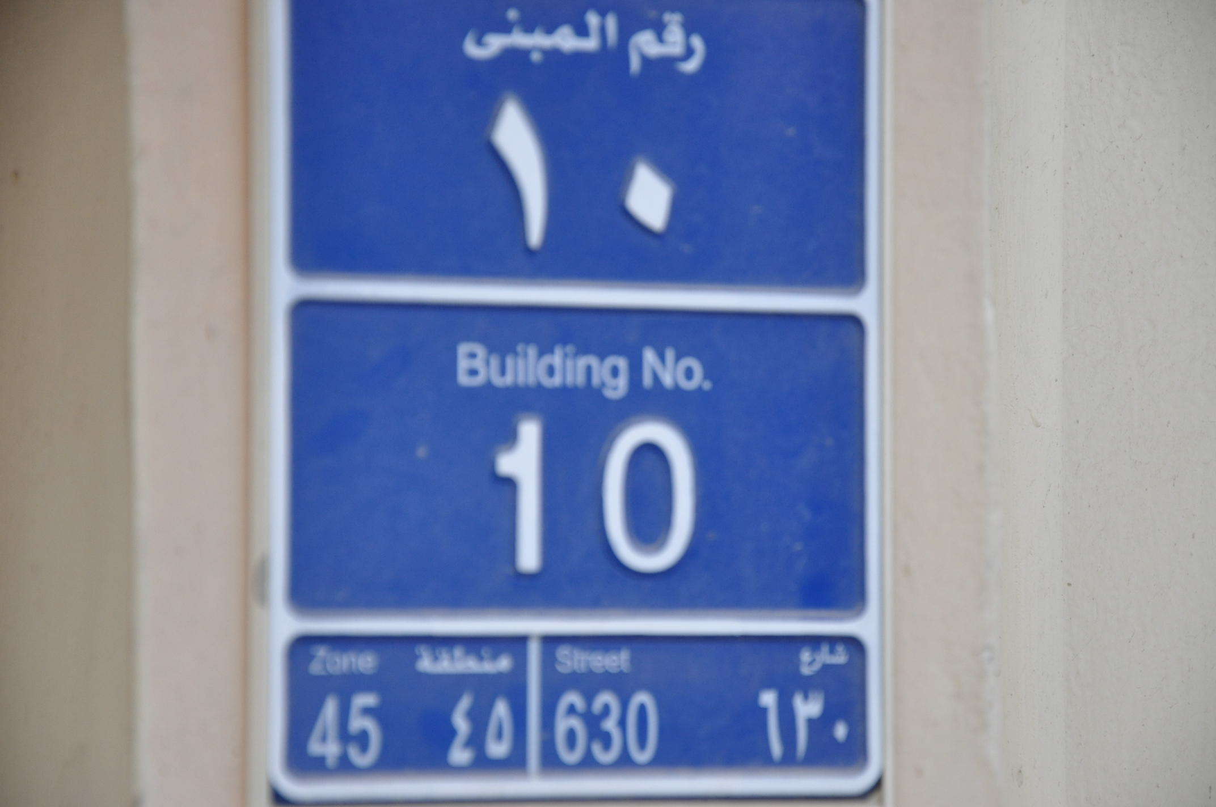

III Method
Street number
Street name
Municipality number
Electricity number
Building Type
Head of household nationality
Number of rooms in the labor camp
Labor camp size (number of labors live in)
GIS point (Latitude and longitude)

Slide 8
III Method
We will estimate :
The proportion of the correct component elements of the house units address, and
Estimate the percentage of the coverage as well of house units in all Zones
Estimate GPS accuracy

Slide 9
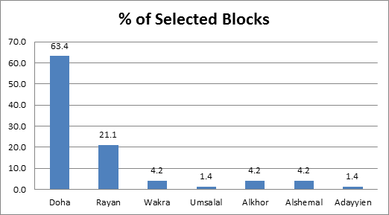
IV Result
1- Coverage
Municipality | no of selected Blocks | %
Doha | 45 | 63.4
Rayan | 15 | 21.1
Wakra | 3 | 4.2
Umsalal | 1 | 1.4
Alkhor | 3 | 4.2
Alshemal | 3 | 4.2
Adayyien | 1 | 1.4
Total | 71 | 100.0

Slide 10
IV Result

Slide 11
IV Result
2- Content errors
Sample type accuracy (Tenant Nationality) :

Slide 12
IV Result

Slide 13
IV Result
3- GPS

Slide 14
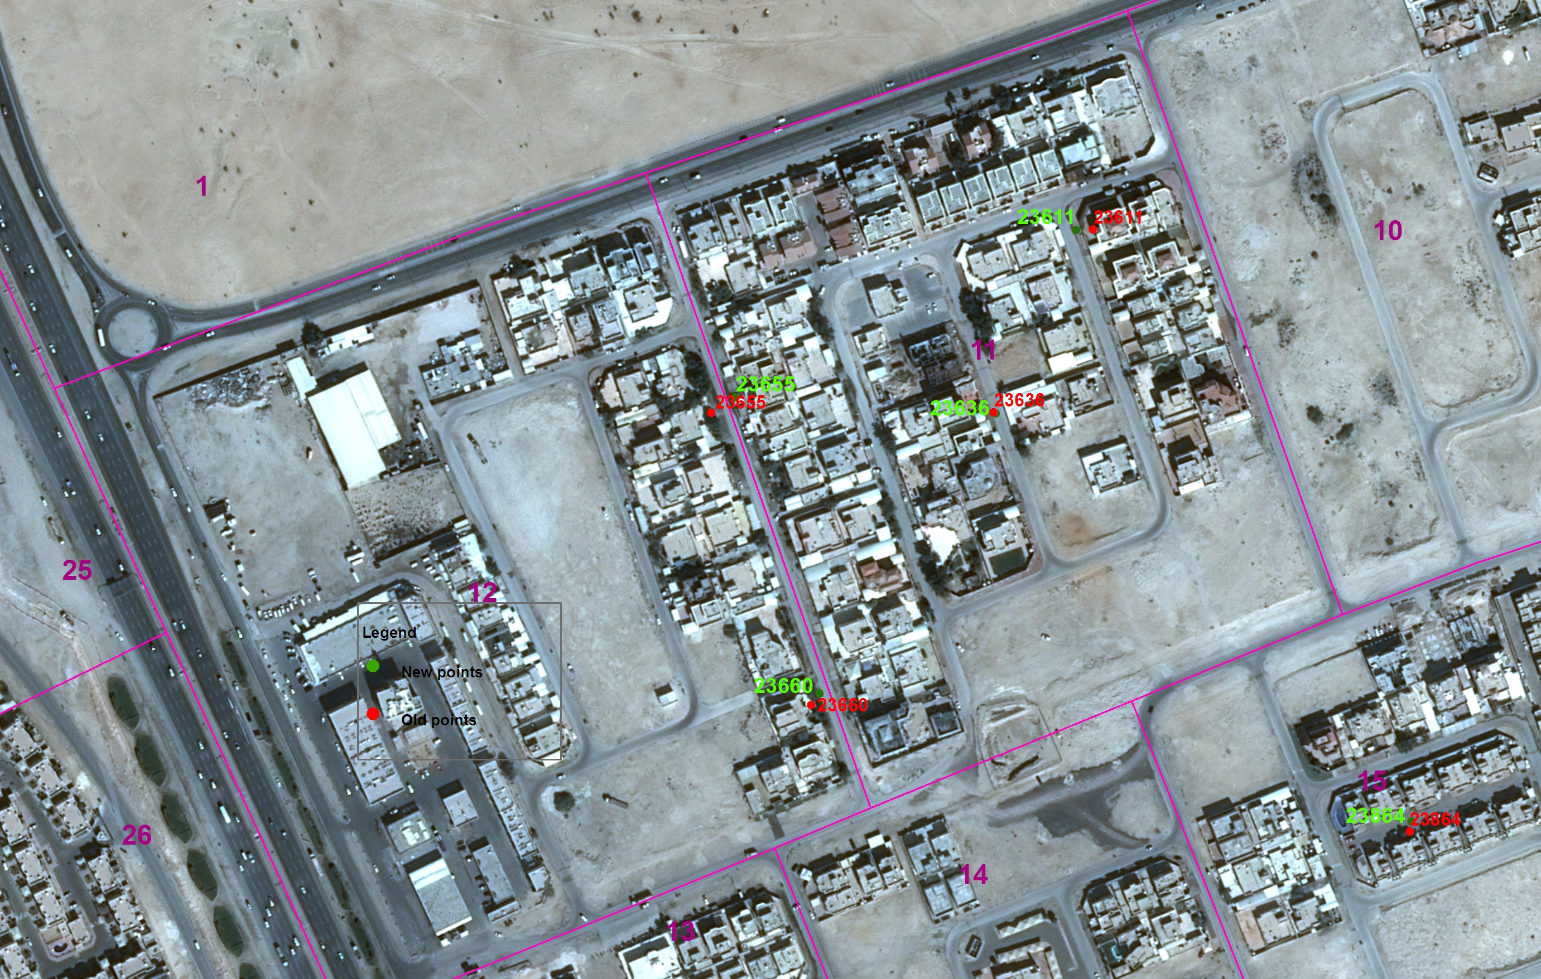
IV Result

Slide 15
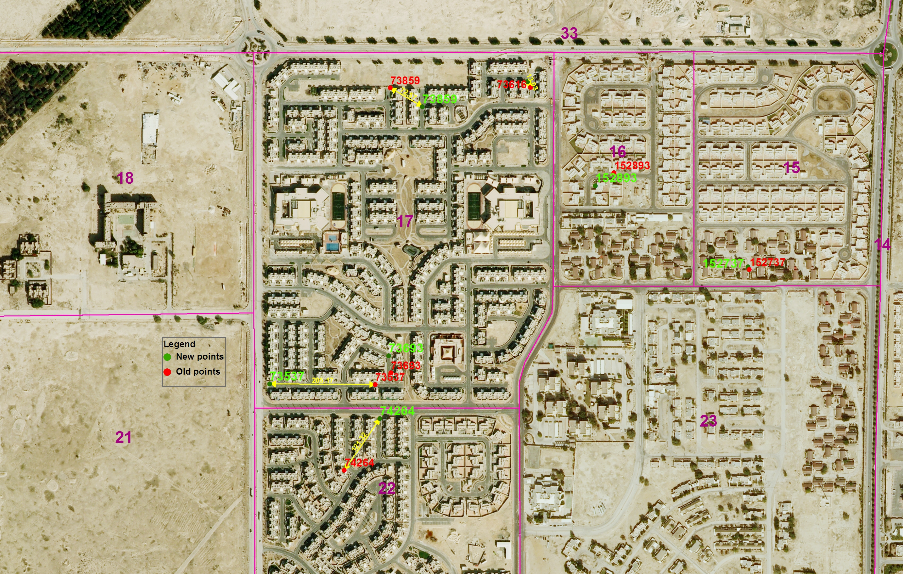
IV Result

Slide 16
IV Result
2014 SESRI Frame
2014 SESRI Frame

Slide 17
Thank you

