Slide 1

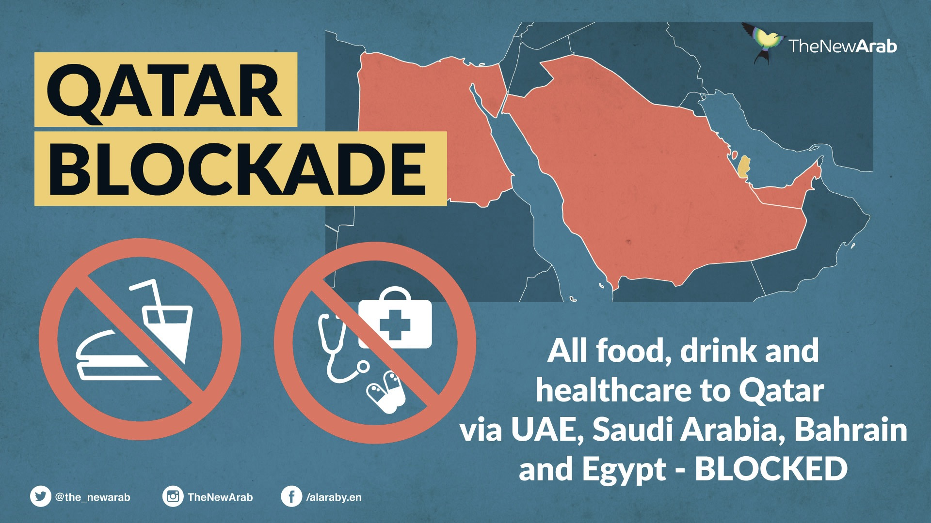
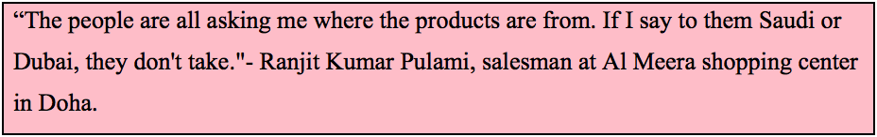
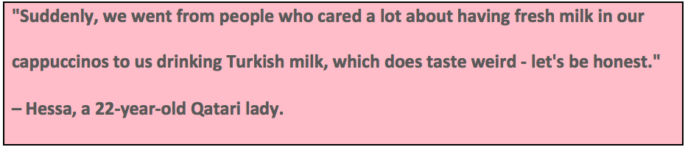
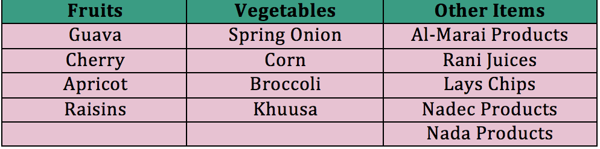
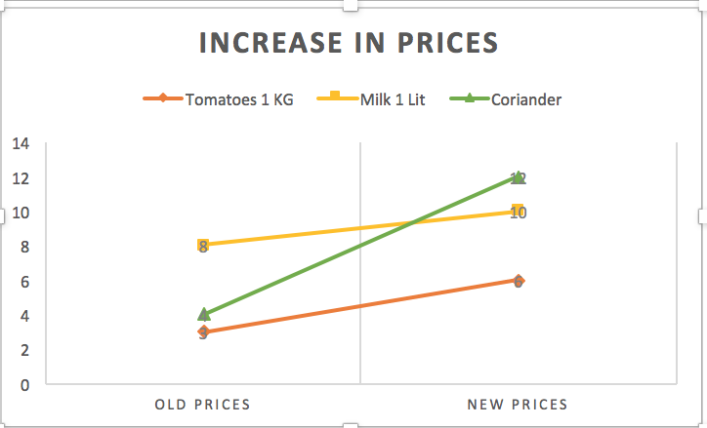
Economic Blockade in Qatar - Impact on Consumer Behaviour
Hajira Rehman Khan
Nadiya Islam
Fathiya Al-Kharusi
Qatar University
INTRODUCTION
The 2017 Qatar diplomatic emergency started when a few nations unexpectedly cut off their diplomatic relationship with Qatar in June 2017. These countries included Saudi Arabia, United Arab Emirates, Bahrain, and Egypt.
The separating of relations included pulling back envoys, and forcing exchange and travel bans. Customers cleared general store racks of products hours after the UAE and Saudi Arabia declared the conclusion of land, ocean and air courses to the emirate.
PURPOSE
The blockade in Qatar has definitely affected consumer behavior in many means. From price increase to various different brands of products in the markets. Turkey and Iran particularly these two countries have been supporting and exporting most of the food items in the region ever since the blockade. Qatar isn't absolutely miserable. With a populace of scarcely two million individuals, for the most part vagrant specialists and expats running administrative occupations, the nation raises with $335 billion in sovereign riches reserves abundance money that has enabled a minor country to end up plainly a noteworthy player in worldwide budgetary center points, from New York to London.
The purpose of this research is to highlight the effects of the blockade on consumer behavior in Qatar and how the country has been able to face these challenges.
CONSUMER REACTION
As Qatar is a country that imports 80% of its food, the initial reaction of the people of Qatar, to the blockade, was to rush to the supermarkets and stock up on food.
A lot of people filled their carts with Al-Marai products (a well known Saudi brand).
Many Qatari citizens as well as expats voluntarily boycotted products from Saudi Arabia and UAE. Even if these items, or whatever was left of them, were being sold on special discount prices, still the Qatari people would opt for Turkish products even though they still hadn’t developed the taste for them.
FOOD SECURITY
According to Professor Zahir Irani, a member of the SAFE-Q, the residents of Qatar should use this crisis as an opportunity to improve their habits of buying and consuming food and find out alternate ways to strengthen their supply of food in the future. For Qatar’s food security program to be successful the consumers need to cooperate and bring about a significant change in their buying and food consumption habits. At present, the residents of Qatar associate global brands with good quality. Therefore, there is a need for marketing and spreading awareness to make consumers understand the meaning the difference between foreign products and good quality. The residents of Qatar, whether locals or expats, will need to understand the need for supporting domestic businesses, even if initially they have to opt for lower quality, in the long run it will benefit their economy. Furthermore, the culture in Qatar of having large buffets for every occasion whether big or small needs to change. Also, ordering large amounts of food every time they go out to eat, even when it is not needed and leaving most of the food, which eventually goes into the waste bins, all these are habits that need to be changed if the people of Qatar want their economy to prosper. It is all a matter of self-restraint and making better choices.
SCARCITY OF FOOD ITEMS:
After the blockade, several food items became scarce in the market.
We chose a sample of five stores and collected data on this. Through our analysis we concluded that due to the blockade, the following items are not easily found in the market.
LITERATURE CITED
http://www.aljazeera.com/blogs/middleeast/2017/06/doha-grocery-rejects-170629150019541.html
http://www.thehindu.com/news/international/life-in-the-blockaded-qatar/article19194173.ece
https://medium.com/dohanews/qatar-should-see-the-blockade-as-a-food-security-wake-up-call-20e464134e91
INCREASE IN PRICES
The graph above shows the increase in prices, after the blockade, of three different food products namely; milk (1 Litre), tomatoes (1 KG) and coriander (1 bunch).
The increase in prices is mainly because of taking a longer air route to deliver the products instead of the shorter one that goes through Saudi Arabia or UAE.

