Slide 1
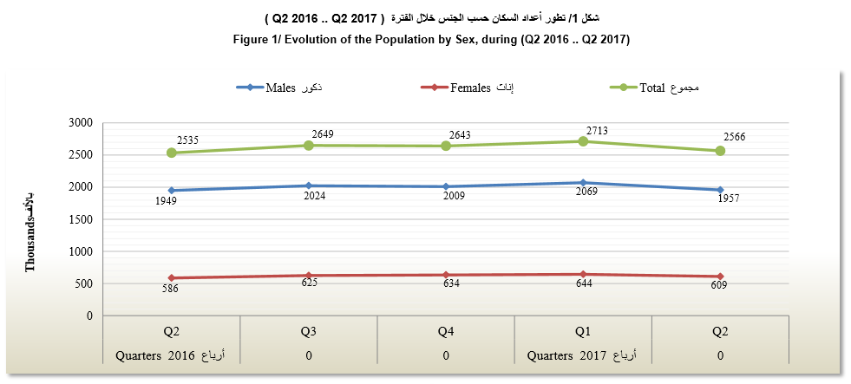
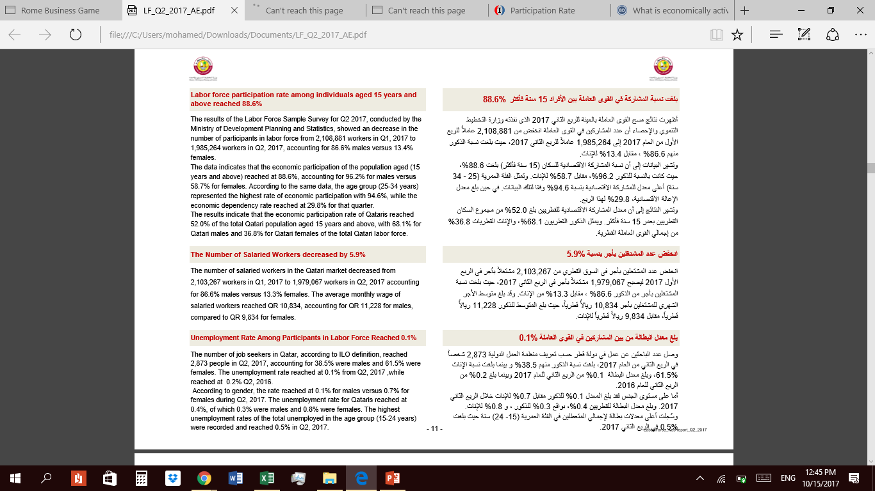
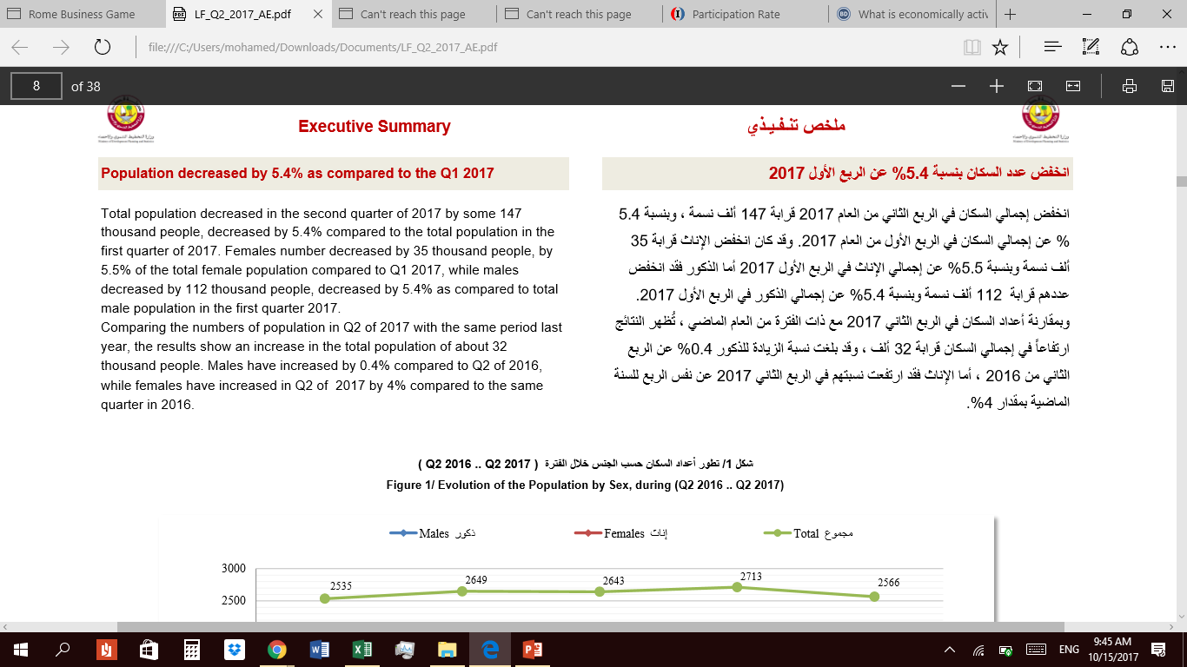
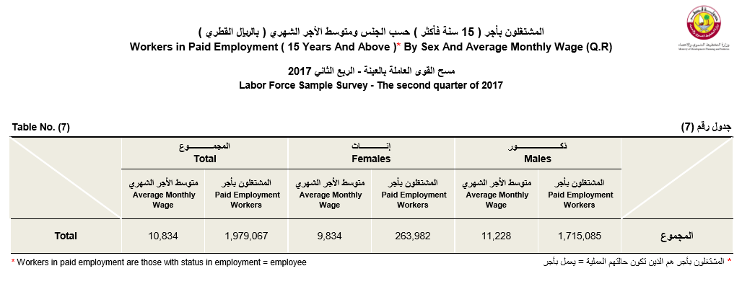
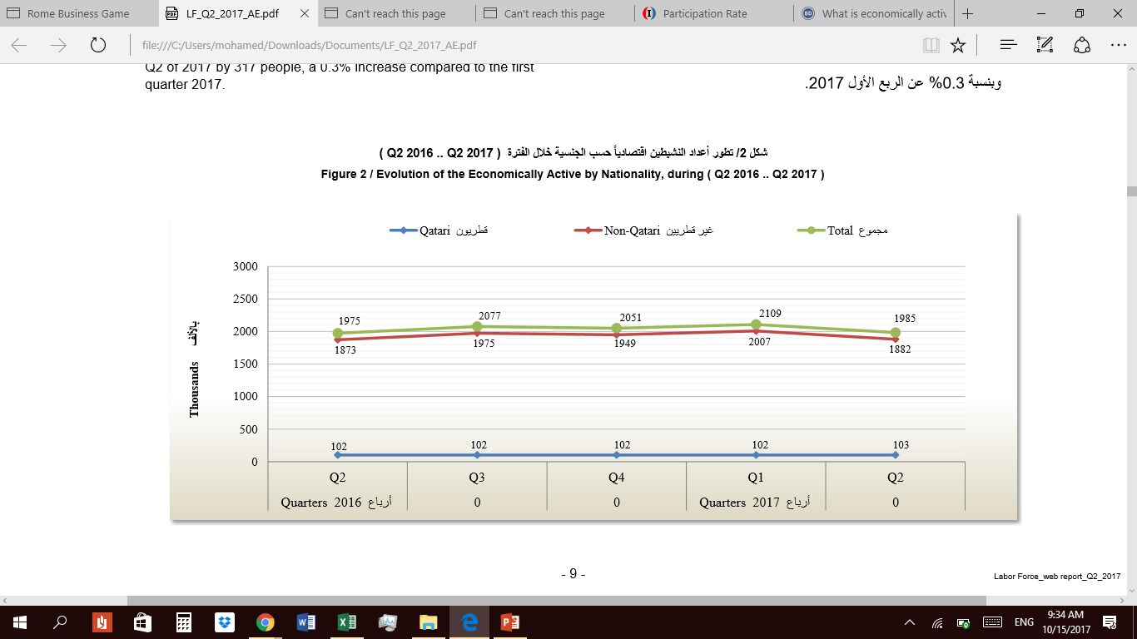
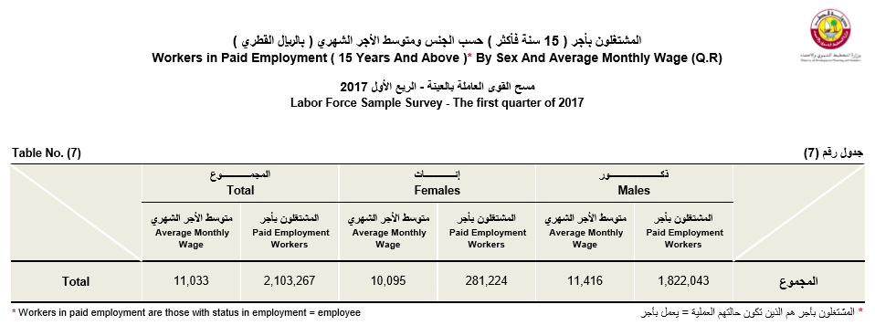
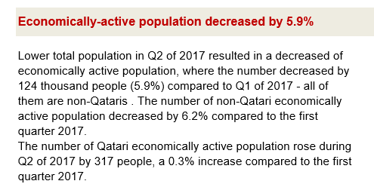
Impact of Blockade on Labor Market
Asmaa Al-Marri 201404190 Nada Ahmed 201405804 Namma Alhussain Hafez 201300450
References:
www.mdps.gov.qa
thepeninsulaqatar.com/article/17/08/2017/Amended-Labour-Law-ensures-speedy-justice-for-workers
www.gulf-times.com/story/559577/Qatar-offers-visa-free-entry-to-citizens-of-80-cou
www.gulf-times.com/story/561185/Emir-issues-new-law-to-protect-domestic-workers
POPULATION
Unemployment rates
Wages
Economically active population
Labor laws
To ensures speedy justice for workers, the Labor Dispute Resolution Committee (LDRC) will be formed within the Ministry of Administrative Development, Labor and Social Affairs. The law indicated that dispute between employee and employer first need to be considered by Department of Labor Relation which must settle the dispute within seven days, otherwise, the department must transfer the case to the dispute committee within three working days. Exceptionally, worker or employee can file case directly to the dispute committee in case of dismissal.
Ministry of Interior (MoI), Qatar Tourism Authority (QTA) and Qatar Airways announced that citizens of 80 countries who want to visit Qatar will be given a multiple-entry waiver for free at the port of entry. The countries include the UK, the US, Seychelles, New Zealand, Canada, Australia, India, and South Africa.
His Highness the Emir Sheikh Tamim bin Hamad Al-Thani issued on Tuesday Law No 15 of 2017 on domestic workers. One of the salient features of the new law is that it also ensures domestic workers end-of-service benefits which shall be a minimum of three weeks wages for each year of service.
Labor force participation rate

